Slide 1





Problem Statement
For $N$ vehicles, given
Initial states, target locations, forbidden locations
Scheduled times of arrival (STA)
Earliest start times (EST)
Determine, with guarantees
Minimum-time trajectories
Latest start times (LST)
Forbidden
Targets
Vehicle
Danger zone

Slide 2
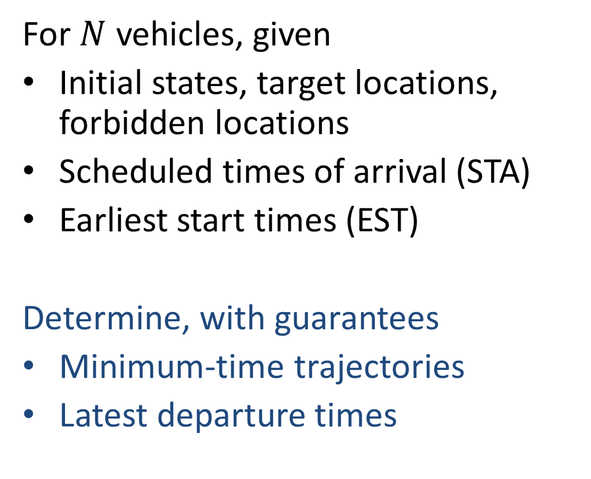
Problem Statement
For $N$ vehicles, given
Initial states, target locations, forbidden locations
Scheduled times of arrival (STA)
Earliest start times (EST)
Determine, with guarantees
Minimum-time trajectories
Latest departure times
Forbidden
Targets
Vehicle
Danger zone

Slide 3
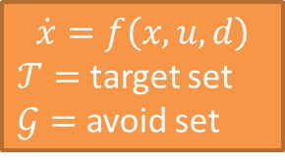
Solution via Basic Reachability Theory
$$\dot{x}=f\left(x,u,d\right)$$
$𝒯=$ target set
$𝒢=$ avoid set

Slide 4
Solution via Basic Reachability Theory
$$\dot{x}=f\left(x,u,d\right)$$
$𝒯=$ target set
$𝒢=$ avoid set
Hamilton-Jacobi Equation
Reachable set
States leading to target and avoiding collisions
Optimal liveness controller

Slide 5


Solution via Basic Reachability Theory
Reachable set
Target set
Avoid set
$$\dot{x}=f\left(x,u,d\right)$$
$𝒯=$ target set
$𝒢=$ avoid set
Hamilton-Jacobi Equation
Reachable set
States leading to target and avoiding collisions
Optimal liveness controller

Slide 6
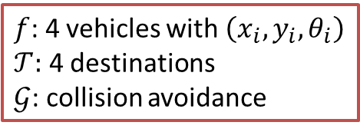
Solution via Basic Reachability Theory
Reachable set
Target set
Avoid set
$$\dot{x}=f\left(x,u,d\right)$$
$𝒯=$ target set
$𝒢=$ avoid set
Hamilton-Jacobi Equation
Reachable set
States leading to target and avoiding collisions
Optimal liveness controller
$f$: 4 vehicles with $\left(x_{i},y_{i},θ_{i}\right)$
$𝒯:$ 4 destinations
$𝒢$: collision avoidance

Slide 7


Solution via Basic Reachability Theory
Reachable set
Target set
Avoid set
Exponential Scaling of Complexity w.r.t. # of vehicles!!
$$\dot{x}=f\left(x,u,d\right)$$
$𝒯=$ target set
$𝒢=$ avoid set
Hamilton-Jacobi Equation
Reachable set
States leading to target and avoiding collisions
Optimal liveness controller
${10}^{10}$ Petabytes
${10}^{12}$ years
$f$: 4 vehicles with $\left(x_{i},y_{i},θ_{i}\right)$
$𝒯:$ 4 destinations
$𝒢$: collision avoidance

Slide 8
Approximate Solution
Joint optimal solution is intractable!
Sequential path planning
Assign vehicle priorities
Treat higher-priority vehicles as moving obstacles
Forbidden
Targets
Vehicle
Danger zone

Slide 9
Approximate Solution
Joint optimal solution is intractable!
Sequential path planning
Assign vehicle priorities
Treat higher-priority vehicles as moving obstacles
Forbidden
Targets
Vehicle
Danger zone

Slide 10
Approximate Solution
Optimal Path Planning in Presence of Moving Obstacles

Slide 11
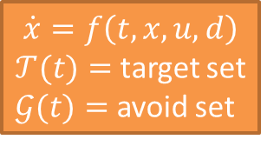
Approximate Solution
Reachable set
Target set
Optimal Path Planning in Presence of Moving Obstacles
Avoid set
$$\dot{x}=f\left(t,x,u,d\right)$$
$𝒯(t)=$ target set
$𝒢(t)=$ avoid set
Hamilton-Jacobi Variational Inequality^{[1]}
Reachable set
States leading to target and avoiding collisions
Optimal liveness controller
[1] Fisac, Chen, Tomlin, Sastry, HSCC 2015

Slide 12
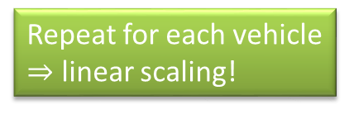
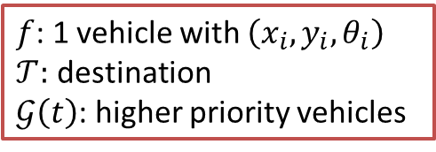
Approximate Solution
Reachable set
Target set
Optimal Path Planning in Presence of Moving Obstacles
Avoid set
$$\dot{x}=f\left(t,x,u,d\right)$$
$𝒯(t)=$ target set
$𝒢(t)=$ avoid set
Hamilton-Jacobi Variational Inequality^{[1]}
Reachable set
States leading to target and avoiding collisions
Optimal liveness controller
Repeat for each vehicle
$⇒$ linear scaling!
$f$: 1 vehicle with $\left(x_{i},y_{i},θ_{i}\right)$
$𝒯:$ destination
$𝒢\left(t\right)$: higher priority vehicles
[1] Fisac, Chen, Tomlin, Sastry, HSCC 2015

Slide 13

Four-Vehicle Example
Dynamics:
$$\dot{x}=v\cos{θ}$$
$$\dot{y}=v\sin{θ}$$
$$\dot{θ}=ω,\left|ω\right|<\overline{ω}$$
Scheduled Times of Arrival

